Slide 1
Thyroid Detection Using Machine Learning
Nikhila Baby
S3 MCA
MAC23MCA-2044
Prof. Nisha Markose
Associate Professor
MCA Dept, MACE

Slide 2
Contents
1. INTRODUCTION
2. LITERATURE REVIEW 1
3. LITERATURE REVIEW 2
4. LITERATURE REVIEW 3
5. SUMMARY
6. PROJECT PROPOSAL
7. DATASET

Slide 3
Contents
8. EXPLORATORY ANALYSIS
9. DATA PREPROCESSING
10. TRENDS AND PATTERNS
11. ALGORITHMS
12. PACKAGES AND FUNCTIONS
13. PROJECT PIPELINE
14. TIMELINE

Slide 4
Introduction
The thyroid gland has one of the most important functions in regulating metabolism.
Detection and accurate diagnosis of hypothyroidism and hyperthyroidism.
Aims to utilize machine learning techniques to improve the detection and diagnosis of thyroid diseases.
Develop and train machine learning models using relevant medical data.

Slide 5
Literature Review

Slide 6
Thyroid disease prediction using selective features and machine learning techniques
1
Focuses on enhancing feature engineering techniques for machine learning.
Machine learning models with enhanced feature engineering are more accurate and computationally efficient for detecting thyroid diseases.
Accuracy of all proposed algorithm is arrived to show the best model.

Slide 7
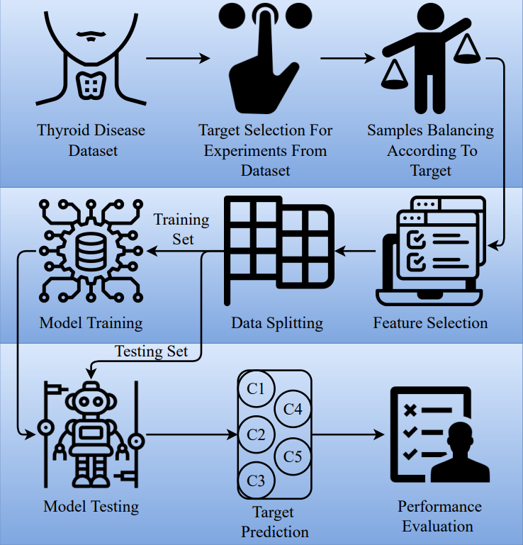
Work Flow
1

Slide 8
Dataset
1
Dataset is collected from UCI repository. The dataset contains 9172 sample observations and each sample is represented by 31 features.
Data sample attribute Types
age | pregnant | goiter | T3_measured | FTI_measured | patient_id
sex | thyroid_surgery | tumor | T3 | FTI
on_thyroxine | I131_treatment | hypopituitary | TT4-measured | TBG_measured
query_on_thyroxine | query_hypothyroid | psych | TT4 | TBG
on_antithyroidmeds | query_hyperthyroid | TSH_measured | T4U_measured | referral_source
sick | lithium | TSH | T4U | Target

Slide 9
Accuracy
1
99%
98%
97%
RF
GBM
ADA
87%
92%
LR
SVM

Slide 10
Detecting thyroid disease using optimized machine learning model based on differential evolution
2
Conditional Generative Adversarial Networks (CGANs) are employed for data augmentation to handle class imbalance effectively.
Hyperparameter optimization is performed using Differential Evolution (DE) algorithm. This algorithm helps to find the best hyperparameter settings for the machine learning models.
Machine learning models are trained on the augmented data.

Slide 11
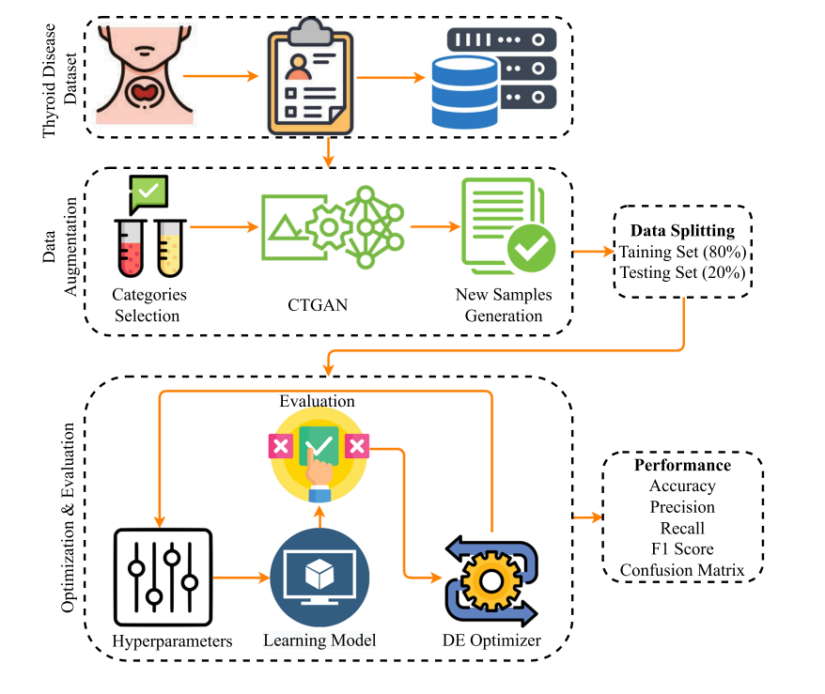
Work Flow
2

Slide 12
Dataset
2
Dataset is collected from Kaggle. The dataset contains 9172 sample observations and each sample is represented by 31 features.
Data sample attribute Types
age | pregnant | goiter | T3_measured | FTI_measured | patient_id
sex | thyroid_surgery | tumor | T3 | FTI
on_thyroxine | I131_treatment | hypopituitary | TT4-measured | TBG_measured
query_on_thyroxine | query_hypothyroid | psych | TT4 | TBG
on_antithyroidmeds | query_hyperthyroid | TSH_measured | T4U_measured | referral_source
sick | lithium | TSH | T4U | Target

Slide 13
Accuracy
2
99.5%
99.6%
99.8%
RF
GBM
ADA
64.3%
96.6%
LR
SVM

Slide 14
An explainable artificial intelligence framework for the predictive analysis of hypo and hyper thyroidism using machine learning algorithms
3
Use machine learning algorithms to predict hypothyroidism and hyperthyroidism based on medical data.
Identifying significant features that enhance the accuracy of disease detection.
Various classification models are tested to classify thyroid diseases.

Slide 15
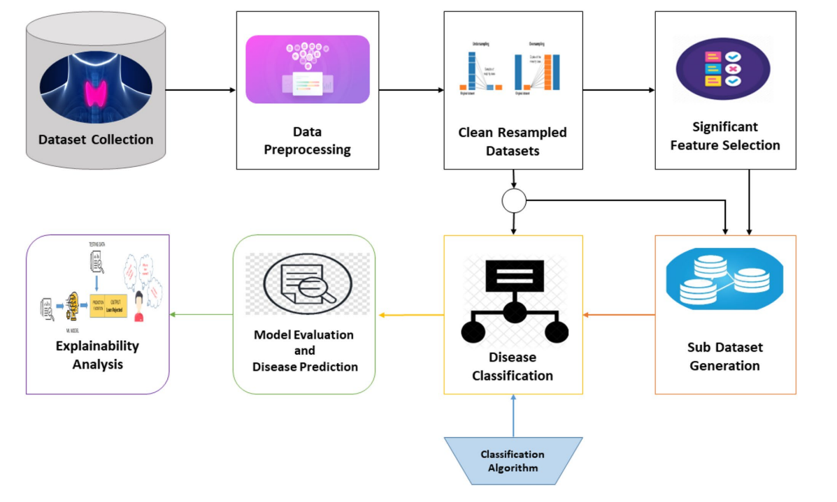
Work Flow
3

Slide 16
Dataset
3
Dataset is collected from UCI repository. The dataset contains 3221 instances with a total of 30 features.
Data sample attribute Types
age | pregnant | goiter | T3_measured | FTI_measured
sex | thyroid_surgery | tumor | T3 | FTI
on_thyroxine | I131_treatment | hypopituitary | TT4-measured | TBG_measured
query_on_thyroxine | query_hypothyroid | psych | TT4 | TBG
on_antithyroidmeds | query_hyperthyroid | TSH_measured | T4U_measured | referral_source
sick | lithium | TSH | T4U | category

Slide 17
Accuracy
3
DT
RF
GBM
90.43%
91.42%
90.5%
NB
KNN
LR
67.86%
86.22%
73.15%
SVM
73.7%

Slide 18
Summary
 | Title | Year | Journal Name | Summary
Paper 1 | Thyroid disease prediction using selective features and machine learning techniques | 2022 | Cancers(MDPI) | RF – 99% GBM – 98% ADA – 97% LR – 87% SVM – 92%
Paper 2 | Detecting thyroid disease using optimized machine learning model based on differential evolution | 2024 | International Journal of Computational Intelligence Systems(Springer) | RF – 99.5% GBM – 99.6% ADA – 99.8% LR – 64.3% SVM – 96.6%
Paper 3 | An explainable artificial intelligence framework for the predictive analysis of hypo and hyper thyroidism using machine learning algorithms | 2023 | Human-Centric Intelligent Systems(Springer) | DT – 90.43% RF – 91.42% GBM – 90.5% NB – 67.86% KNN – 86.22% LR – 73.15% SVM – 73.7%

Slide 19
Project Proposal
Comparative study of three algorithms.
RF
LR
SVM
Why Random Forest ?
Accuracy
Figure out which features
are most important.
Why Logistic Regression ?
Gives probabilities for each class, helping to understand how confident the model is in its predictions
Why Support vector machine?
Consistently delivers good results especially with high-dimensional data
avoiding overfitting

Slide 20
Project Proposal
Classification of thyroid disease under three classes.
Hypothyroid
Hyperthyroid
No Thyroid
Helpful to medical experts to make disease predictions without any human mistakes.
Patients can diagnose their condition without the assistance of a medical expert.

Slide 21
Dataset
Dataset is taken from Kaggle Repository.
9172 samples and every sample has 31 features.
Contains numeric values and Boolean values.
Class labels include letters from A to T which indicates different thyroid conditions.
https://www.kaggle.com/datasets/emmanuelfwerr/thyroid-disease-data

Slide 22
Dataset Attributes
age | age of the patient | I131_treatment | whether patient is undergoing I131 treatment
sex | gender of the patient | query_hypothyroid | whether the patient believes they have hypothyroid
on_thyroxine | whether patient is on thyroxine medication | query_hyperthyroid | whether the patient believes they have hyperthyroid
query_on_thyroxine | Whether the patient is queried for thyroxine medication | lithium | whether patient is on lithium
on_antithyroidmeds | whether the patient is on antithyroid medication | goiter | whether patient has goitre
sick | whether patient is sick | tumor | whether patient has tumor
pregnant | whether patient is pregnant | hypopituitary | whether patient has hyperpituitary gland
thyroid_surgery | whether patient has undergone thyroid surgery | psych | whether patient has psychological conditions

Slide 23
TSH_measured | whether TSH was measured in the blood | FTI_measured | whether FTI was measured in the blood
TSH | TSH level in blood from lab work | FTI | FTI level in blood from lab work
T3_measured | whether T3 was measured in the blood | TBG_measured | whether TBG was measured in the blood
T3 | T3 level in blood from lab work | TBG | TBG level in blood from lab work
TT4-measured | whether TT4 was measured in the blood | referral_source | The source of referral
TT4 | TT4 level in blood from lab work | Target | target classification for the patient's thyroid condition.
T4U_measured | whether T4U was measured in the blood | patient_id | unique id of the patient
T4U | T4U level in blood from lab work

Slide 24
Class Labels
Class labels include letters from A to T which indicates different thyroid conditions
Hyperthyroid
Hypothyroid
No Thyroid
A Hyperthyroid
B T3 toxic
C Toxic goitre
D Secondary toxic
E Hypothyroid
F Primary hypothyroid
G Compensated
hypothyroid
H Secondary
hypothyroid
I Increased binding
protein
J Decreased binding
protein
K Concurrent
non-thyroidal illness
L Consistent with
replacement therapy
M Underreplaced
N Overreplaced
O Antithyroid drugs
P I131 treatment
Q Surgery
R Discordant array
results
S Elevated TBG
T Elevated thyroid
hormones

Slide 25
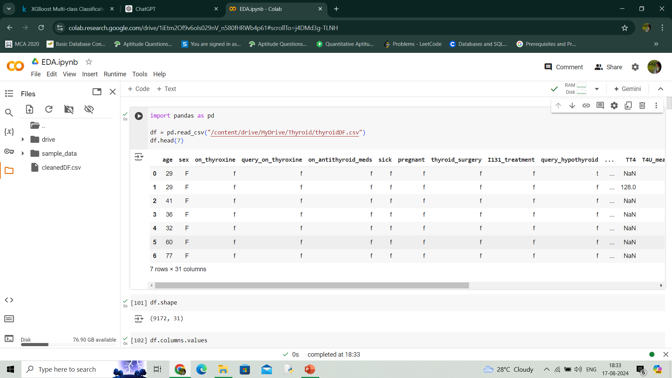
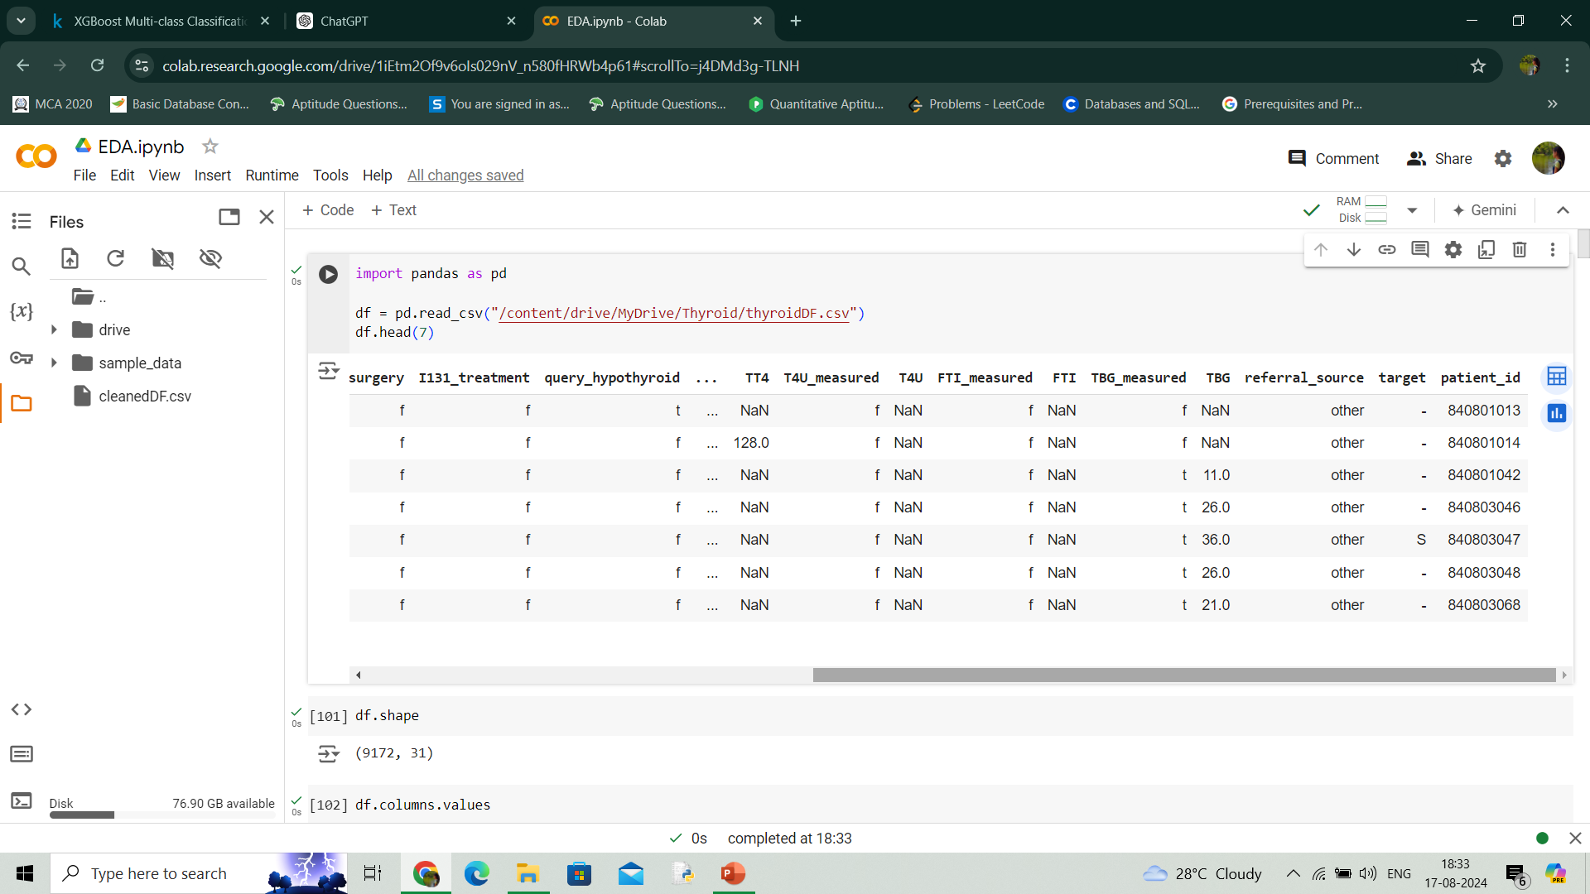
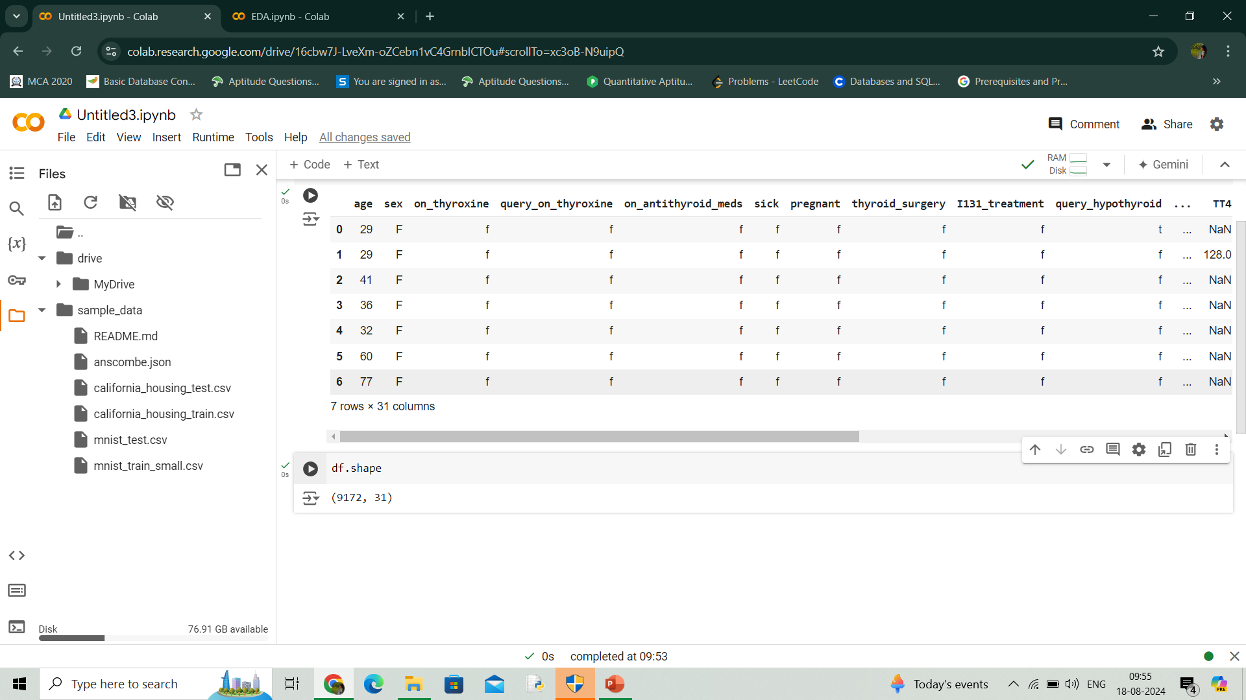
DATASET EXPLORATION
Dataset has 9172 data points and 31 features

Slide 26
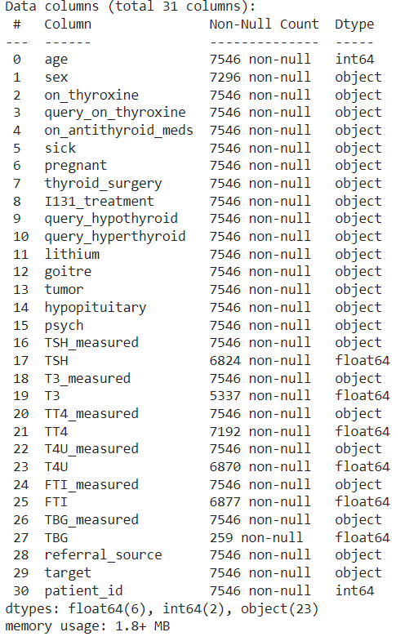
Dataset contains 8 numerical attributes and 23 categorical attributes including target class.
There are missing values in the dataset.

Slide 27
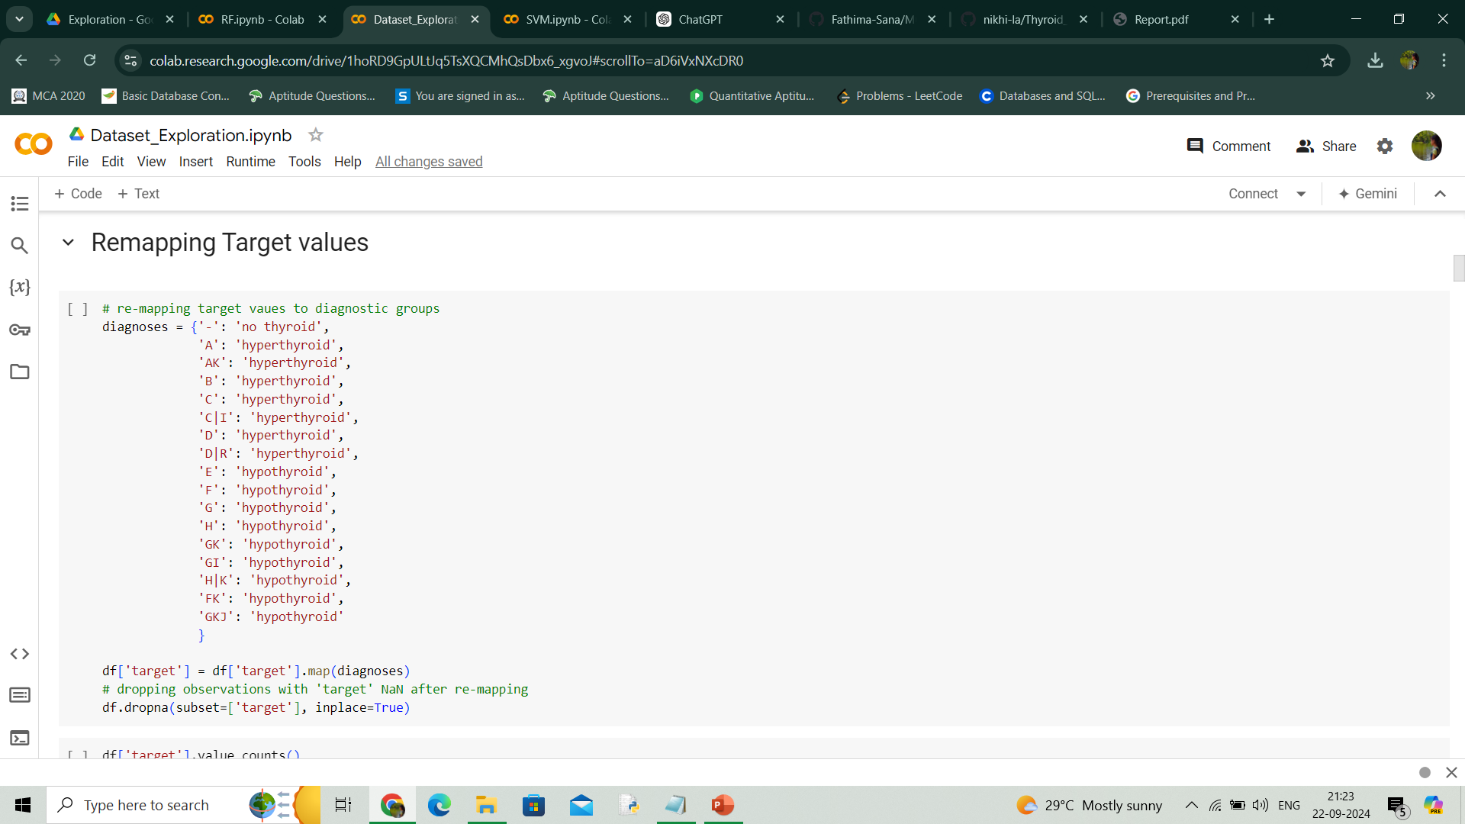
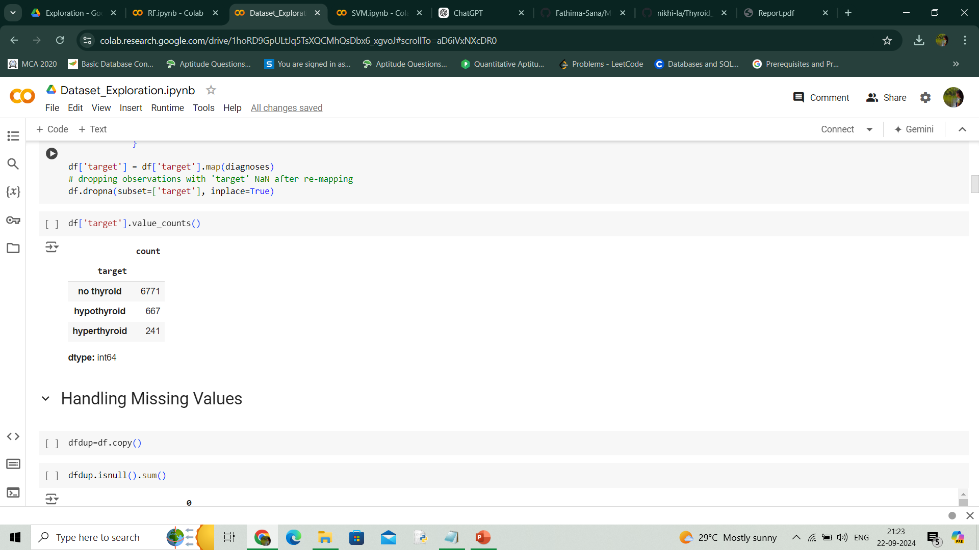
Class labels are remapped as no thyroid, hypothyroid and hyperthyroid.

Slide 28
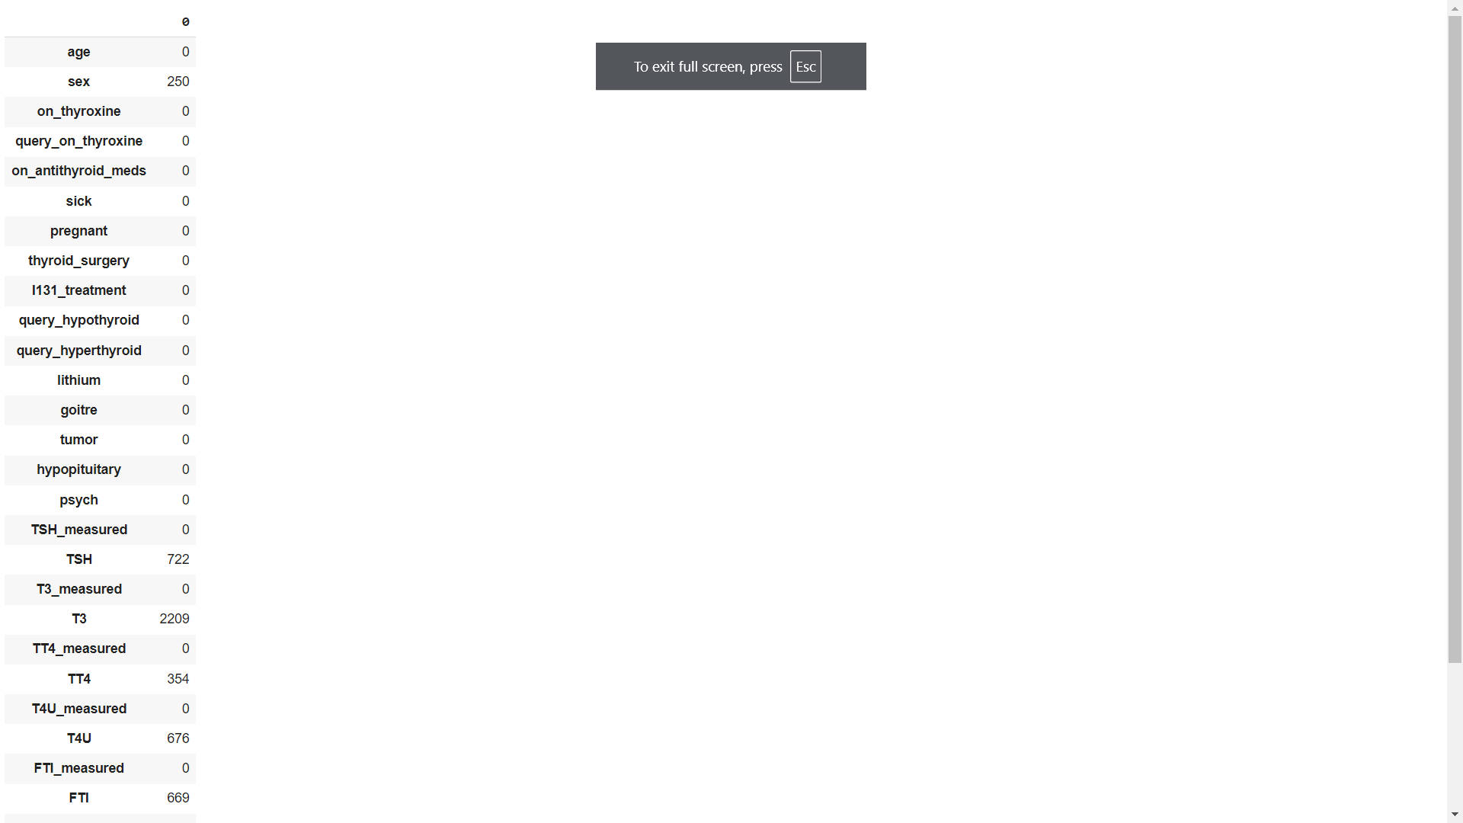
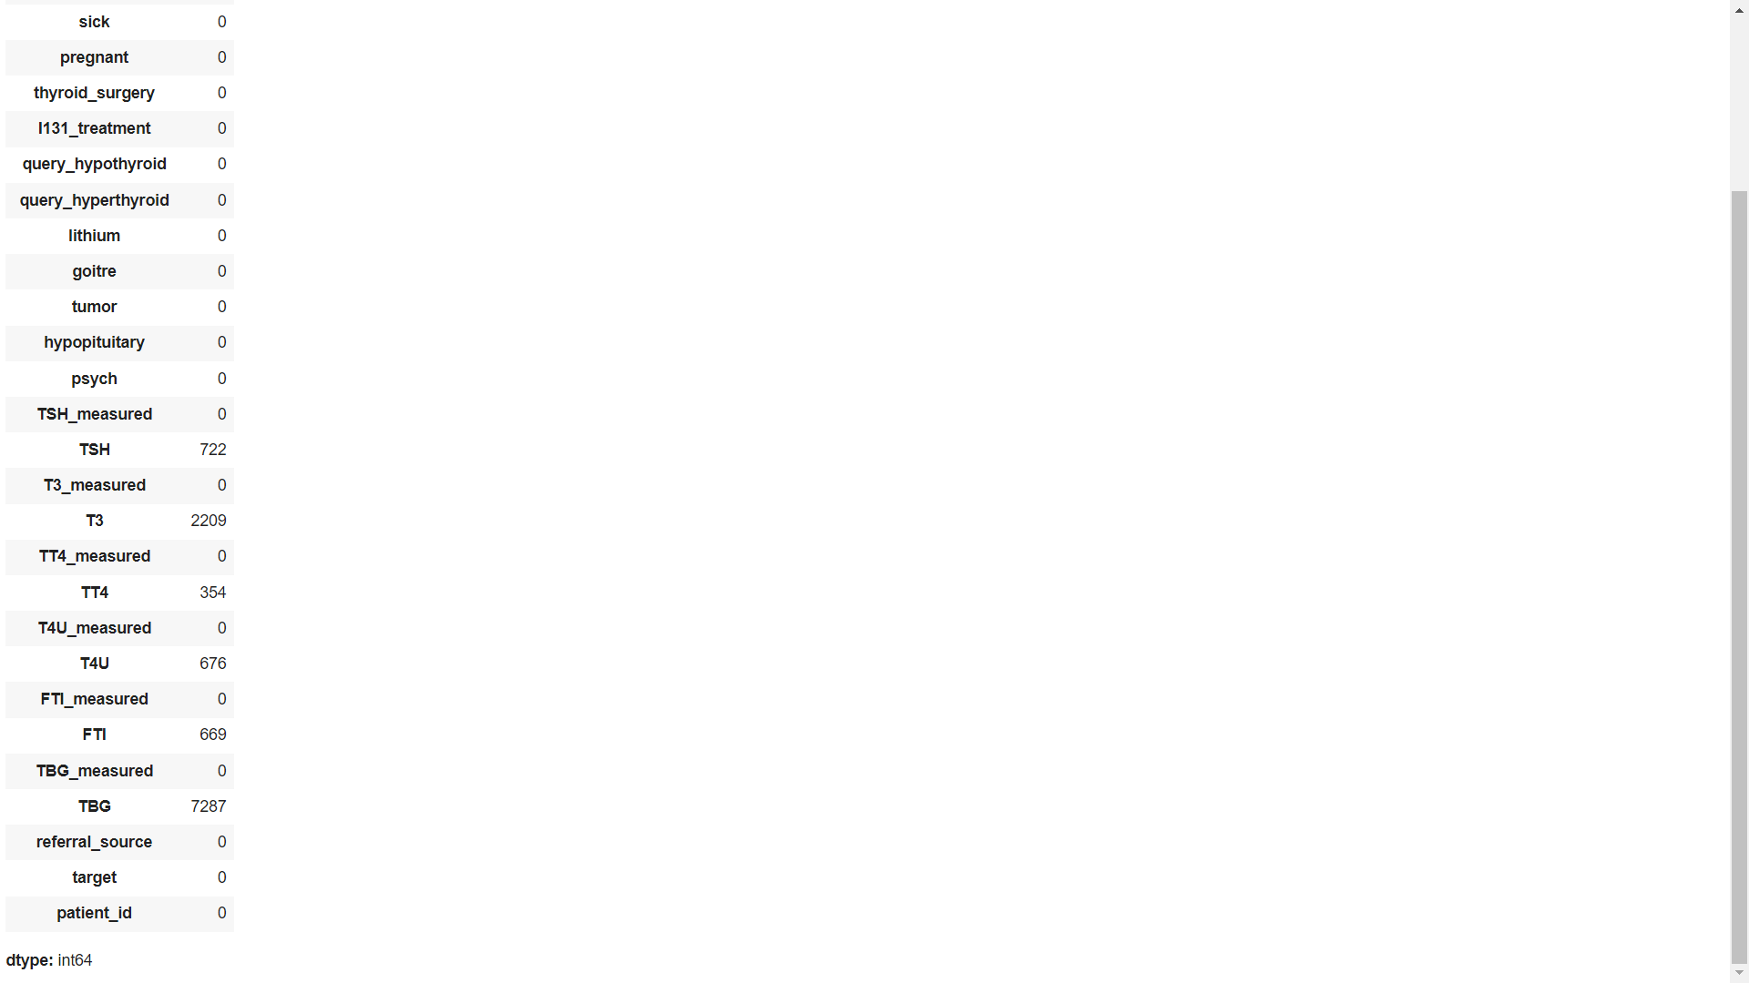
Checking for missing values
Sex has 3.3 % missing values.
TSH has 9.56 % missing values.
T3 has 29.2 % missing values.
TT4 has 4.69 % missing values.
T4U has 8.95% missing values.
FTI has 8.8 % missing values.
TBG has 96 % missing values.

Slide 29
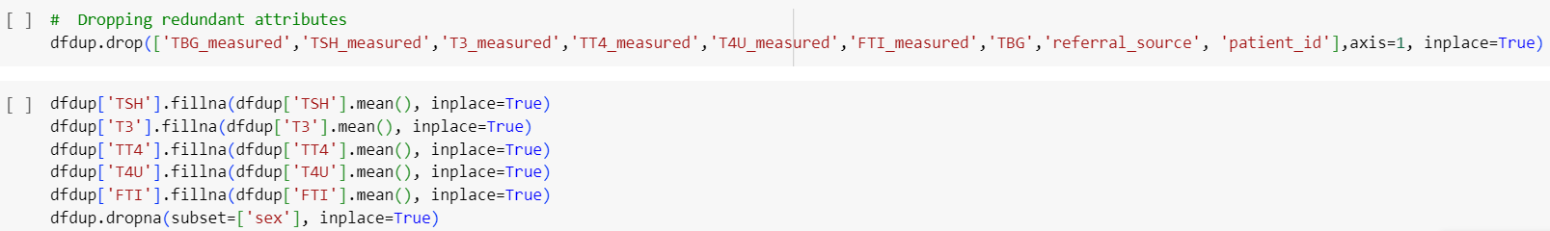
Patient_id and referral_source are irrelevant attributes. So these attributes are dropped.
TBG_measured,TSH_measured,T3_measured,TT4_measured,T4U_measured,FTI_measured are redundant attributes. They are dropped.
TBG has a very high number of missing values. It is dropped.
Missing values in the sex are dropped.
The other missing values are replaced using the mean and mode values.

Slide 30
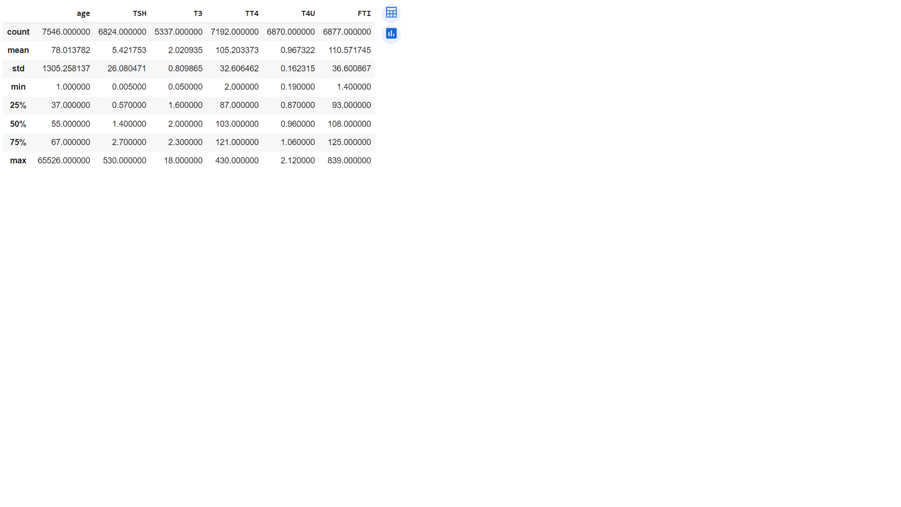
Age has a very high standard deviation and maximum value is 65526 which suggests there are outliers.
TSH has high standard deviation possibly the presence of an outlier or indicating severe thyroid condition.
TT4 levels ranges between 2 to 430, possibly due to different thyroid conditions or outliers.
FTI values from 1.4 to 839 suggest the presence of outliers or a wide range of thyroid conditions.

Slide 31
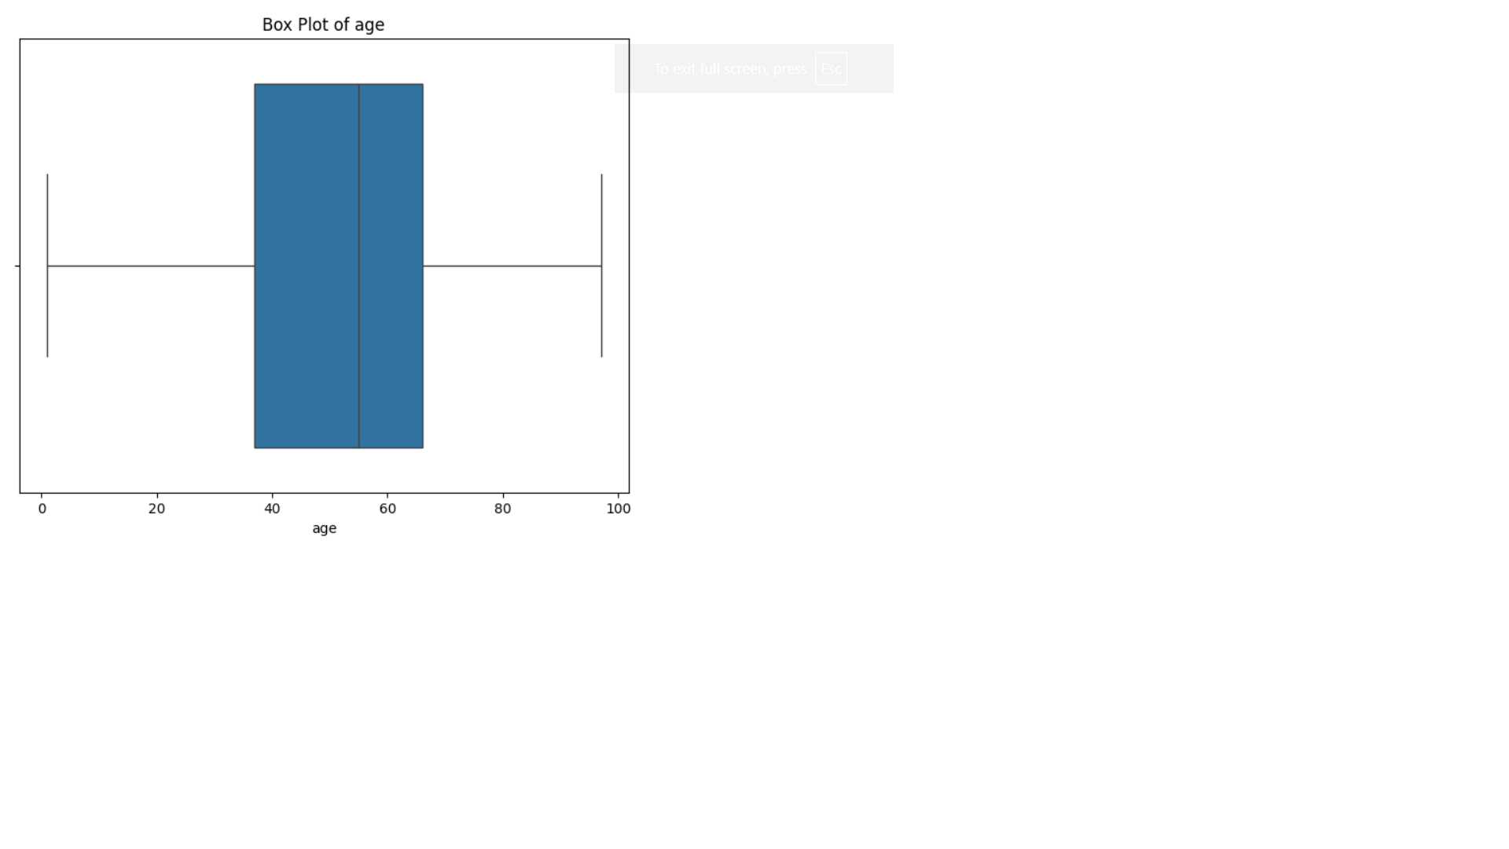
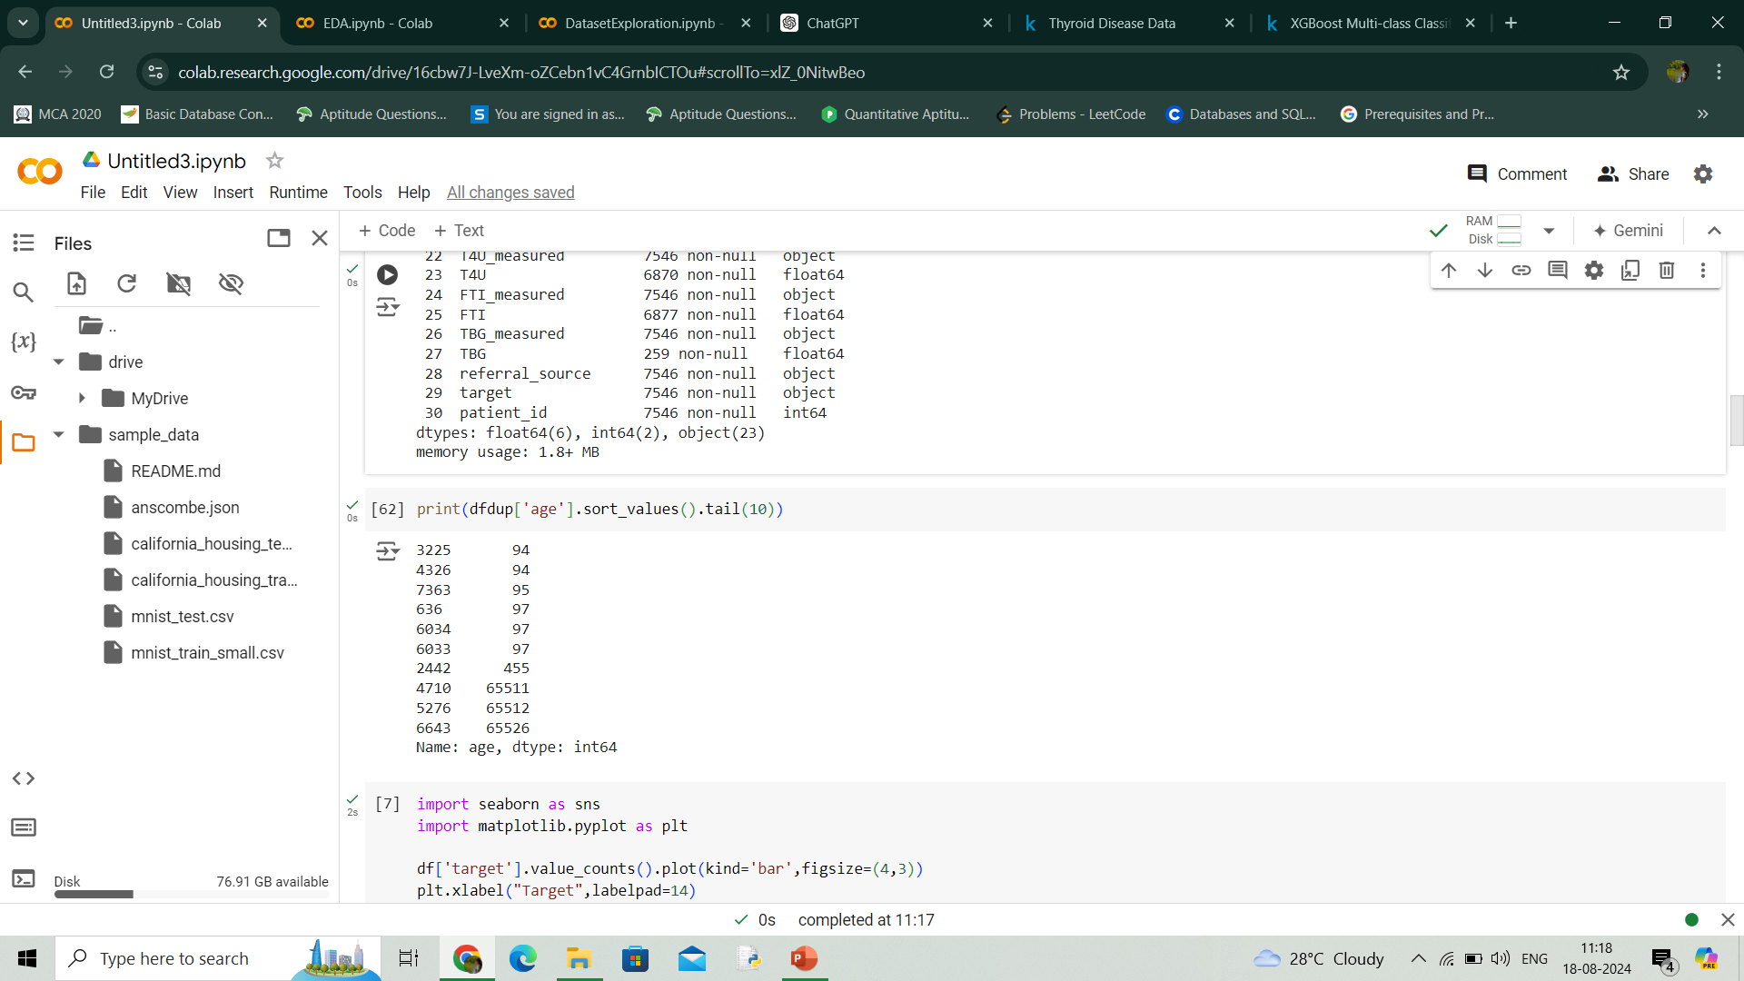
Handling outliers
Age above 100 is considered outliers and they are removed
After handling outlier

Slide 32
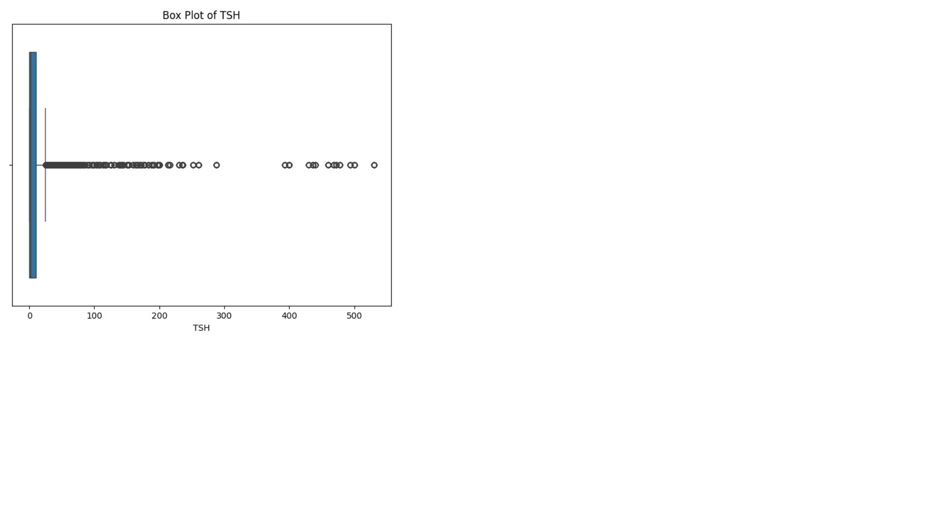
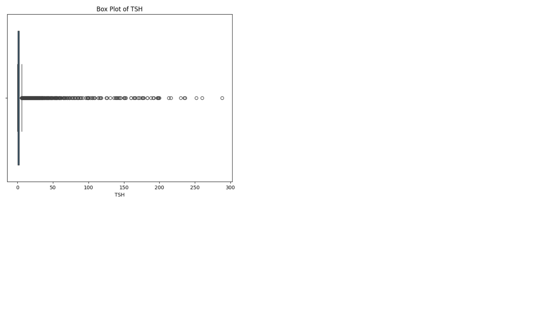
TSH is showing severe outliers. However some of them indicate severe thyroid conditions .
Values above 300 is removed
After removing outlier

Slide 33
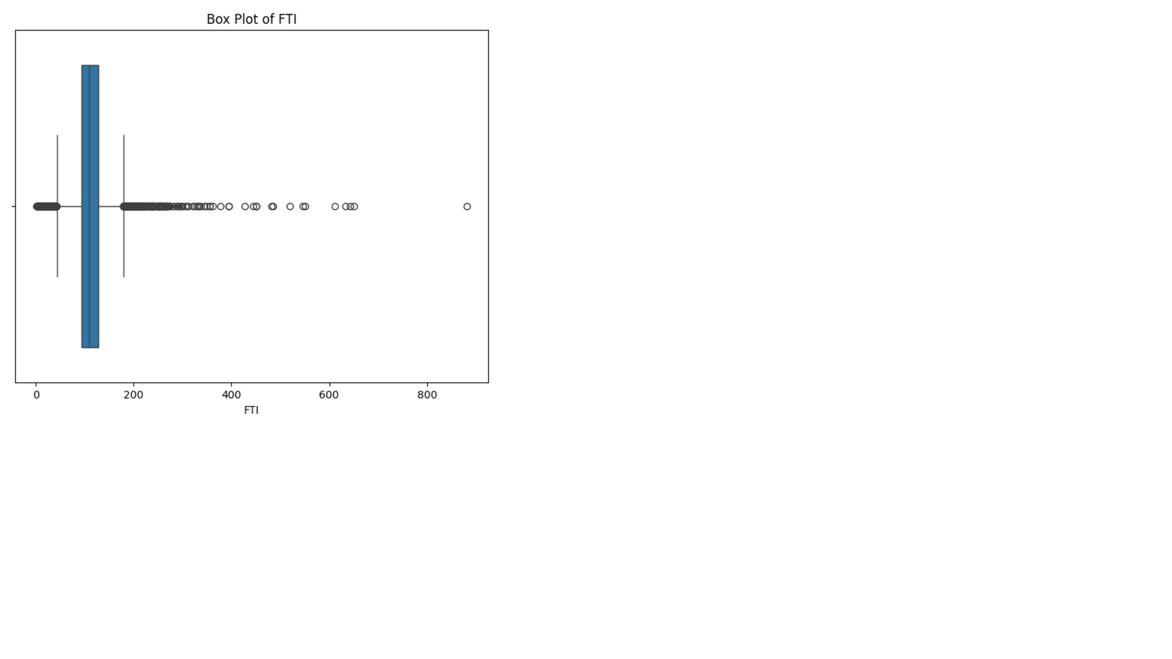
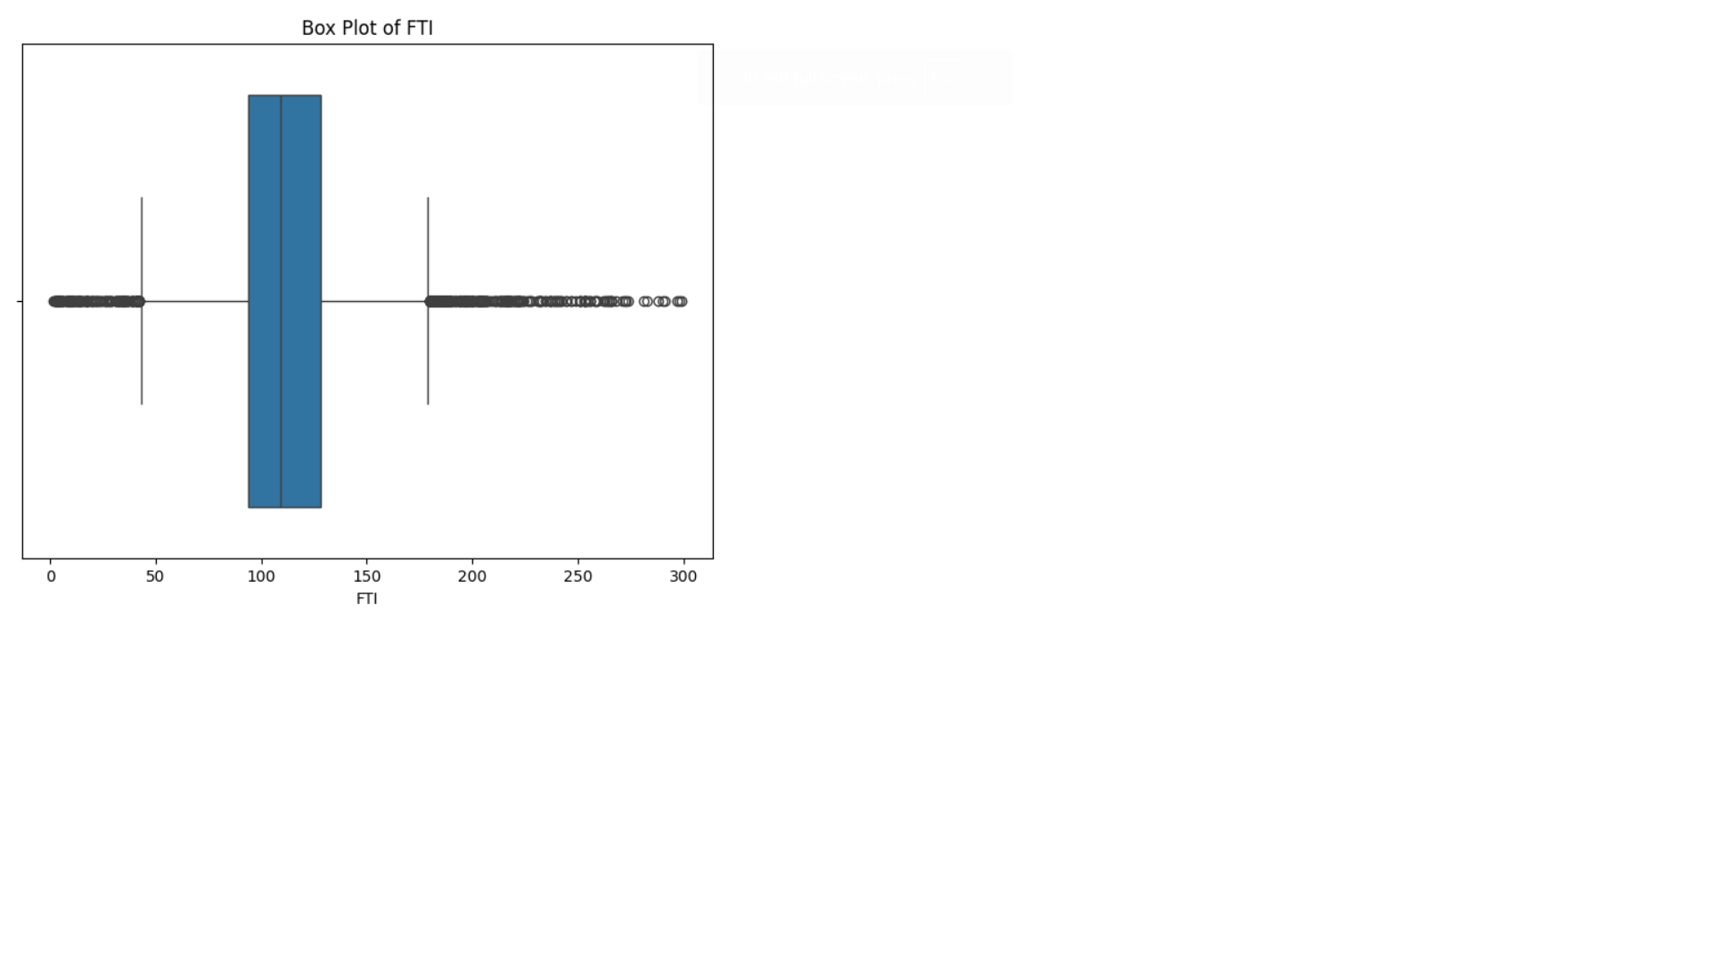
FTI is showing severe outliers. However some of indicate severe thyroid conditions .
Values above 400 is removed
After removing outlier

Slide 34
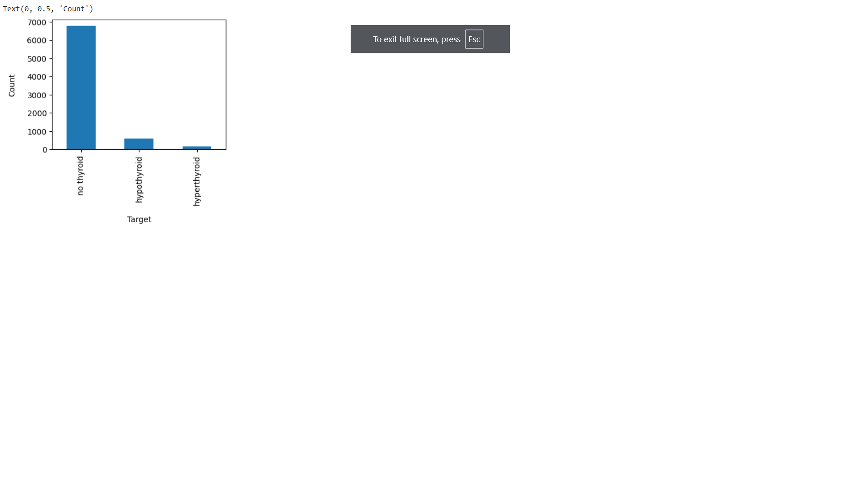
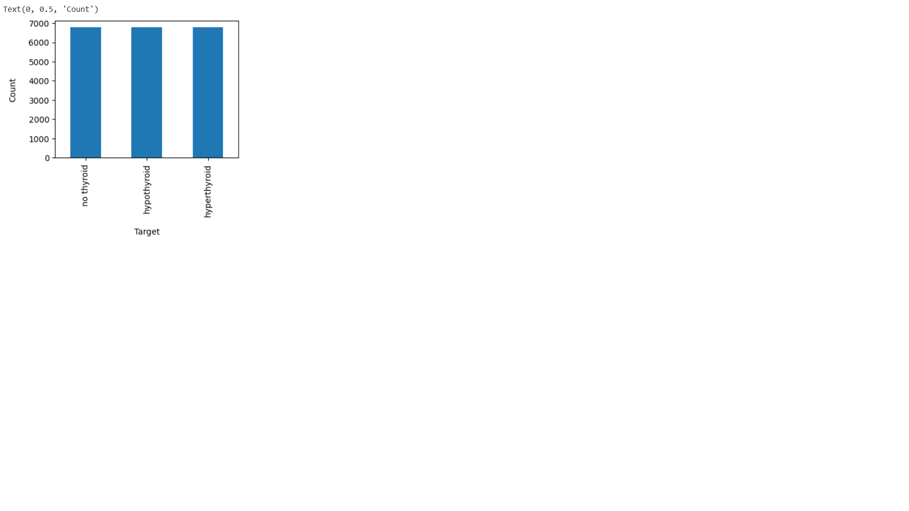
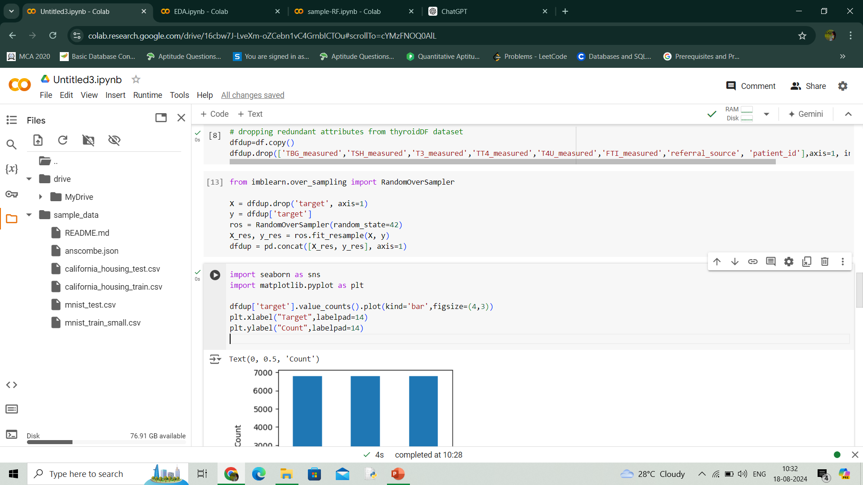
Class Imbalance
Target class is highly imbalanced. There are large number of people with no thyroid and comparatively small number of people with hypothyroid and hyperthyroid.

Slide 35
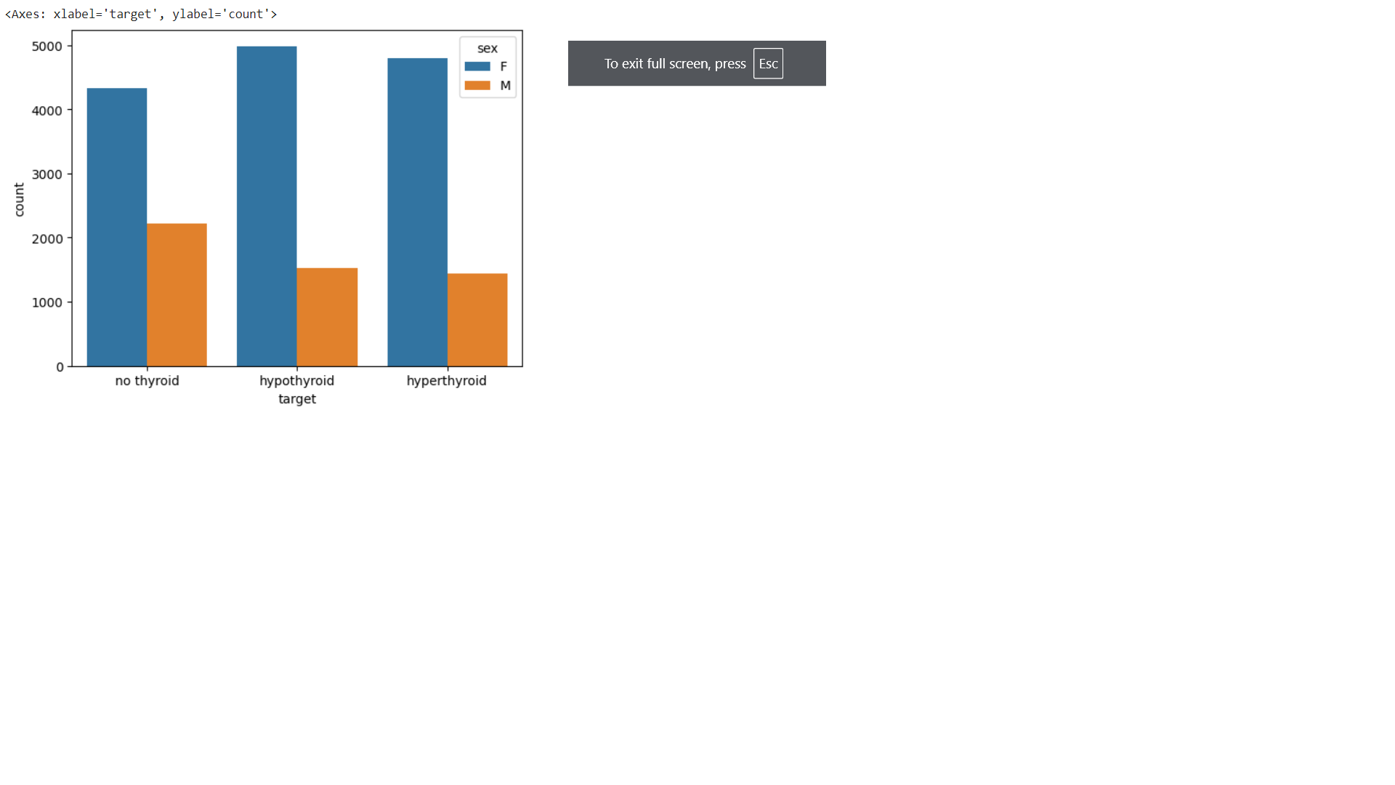
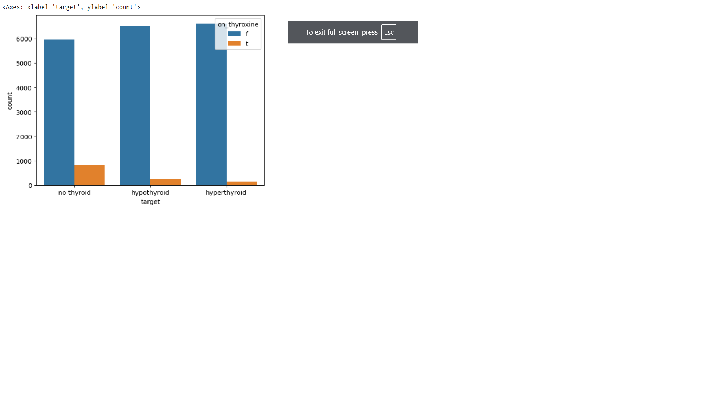
PATTERNS
Sex
On_thyroxine
Those who are not taking thyroxine medications are likely to be caused by hypo and hyper thyroid.
Females are more likely to be affected by hypo and hyperthyroid

Slide 36
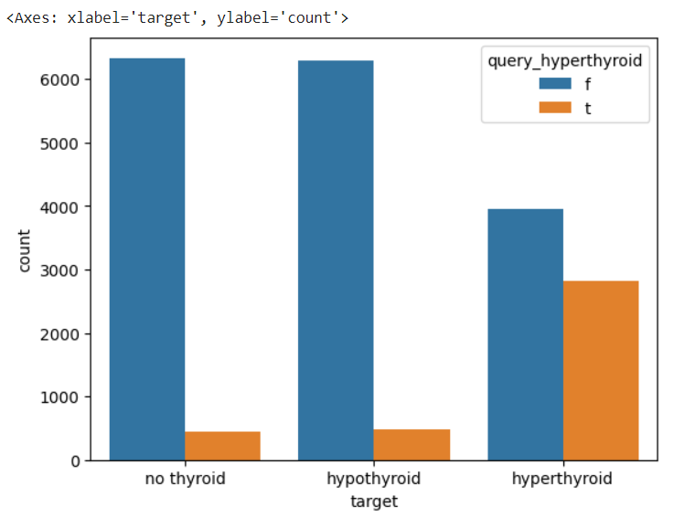
query_hyperthyroid
Those who queried about hyperthyroid are more likely to be affected by hyperthyroid.

Slide 37
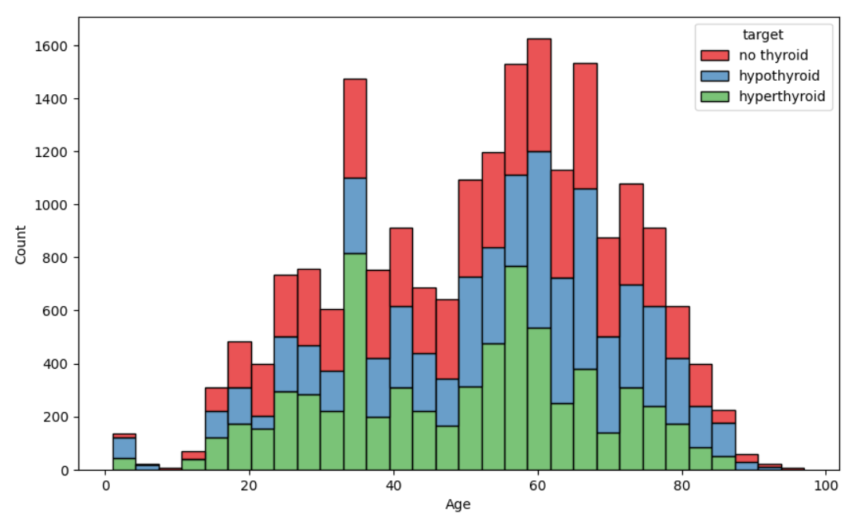
Age
Age in the range from 20 to 80 are more likely to be affected by thyroid disease.

Slide 38
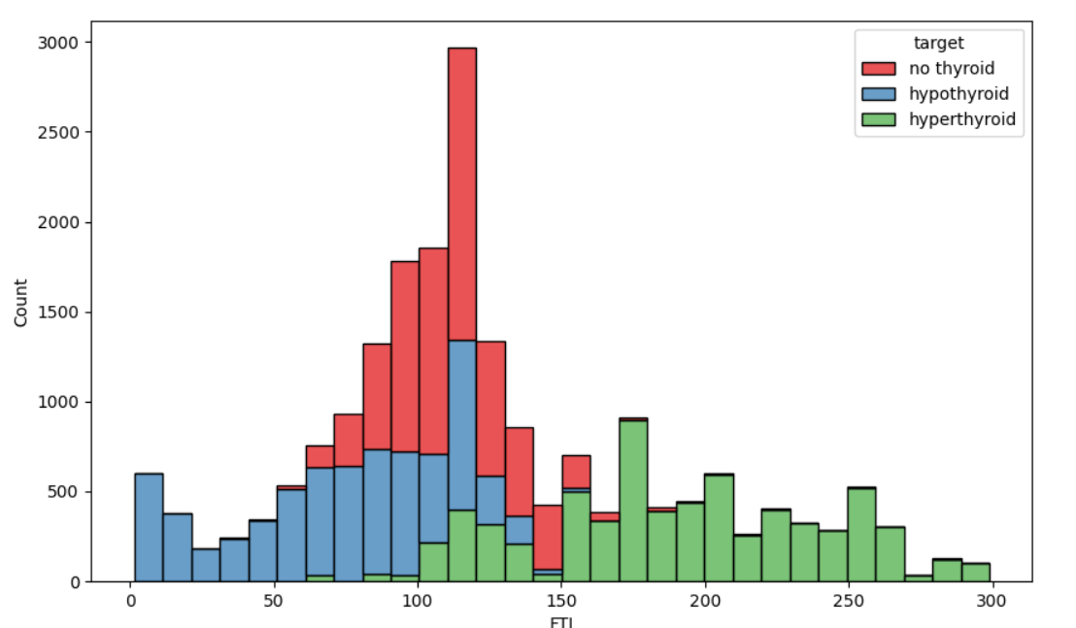
FTI
Higher level of FTI causes hyperthyroid and lower level of FTI causes hypothyroid.

Slide 39
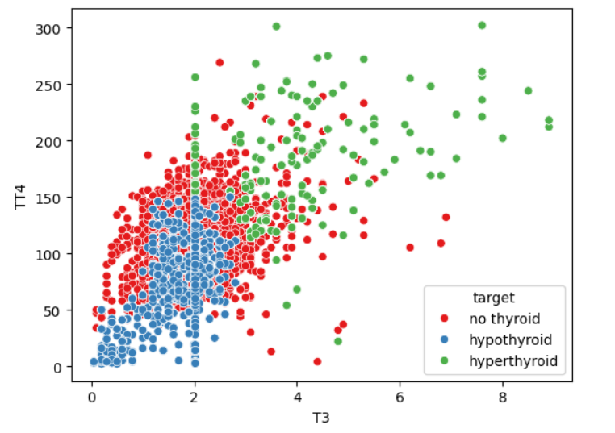
TT4 and T3
Low TT4 and low T3 causes hypothyroid and high TT4 and high T3 causes hyperthyroid.

Slide 40
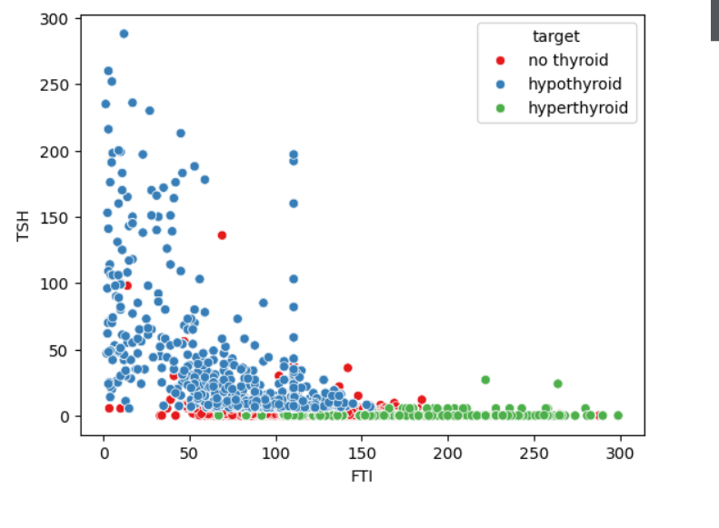
TSH and FTI
Low TSH and high FTI causes hyperthyroid and high TSH and low FTI causes hypothyroid.

Slide 41
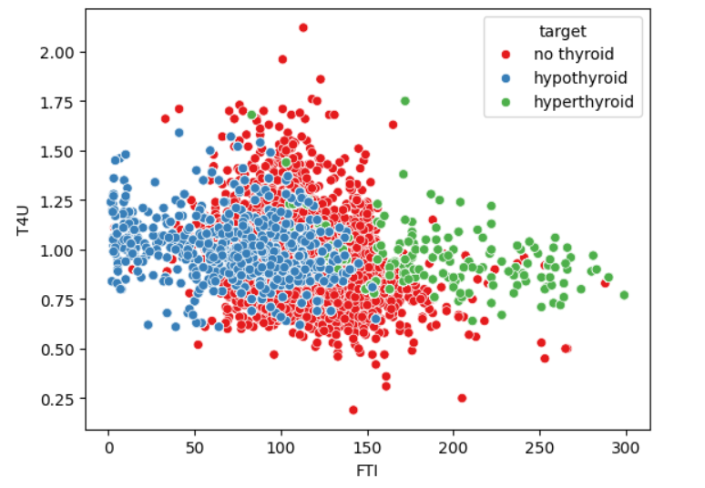
T4U and FTI
Increase in FTI causes hyperthyroid and decrease in FTI causes hypothyroid

Slide 42
Insights
Age in the range from 20 to 80 are more likely to be affected by thyroid disease.
Lower level of T3 causes hypothyroid and higher level causes hyperthyroid.
Increase in TSH value causes hypothyroid and decrease in TSH value causes hyperthyroid.
Lower level of TT4 causes hypothyroid and higher level causes hyperthyroid.
Increase in the FTI level leads to hyperthyroid and decrease in the level causes hypothyroid.
Females are more likely to be affected by hypo and hyperthyroid.
Those who are not taking thyroxine medications are likely to be caused by hypo and hyperthyroid.
Those who queried about hyperthyroid are more likely to be affected by hyperthyroid.

Slide 43
RANDOM FOREST
Supervised learning technique
Based on the concept of ensemble learning, which is a process of combining multiple classifiers to solve a complex problem and to improve the performance of the model.
Works by constructing a collection of decision trees
Random forest takes the prediction from each tree and based on the majority votes of output, it takes the final output.

Slide 44
How does RF algorithm work?
Random forest select random K data points and features from the training set.
Build the decision trees associated with the selected data points (Subsets).
Build N number of decision trees .
Each decision tree will generate output.
For new data points, find the output of each decision tree, and assign the new data points to the category that wins the majority votes.
Random forest handles complex datasets
Stability arises because the result is based on majority voting.

Slide 45
Pseudocode
1. Input:
- Training dataset with N samples and M features.
- Number of trees to create: T.
- Number of features to randomly select at each split: F.
2. Initialize an empty list called 'forest' to store the trees.
3. For each tree (from 1 to T):
a. Create a random sample of the training data (some samples may repeat).
b. Build a decision tree:
i. At each decision point in the tree:

Slide 46
- Randomly pick F features.
- Find the best feature and split point among the F features to split the node - Split the node into two child nodes based on the selected split point.
ii. Keep splitting until the tree is fully grown or meets some stopping condition
(like a max depth or minimum samples).
c. Add this decision tree to the 'forest'.
4. To make a prediction for a new sample x:
a. Let each tree in the forest make a prediction.
b. The final prediction is the one that most trees agree on (majority vote).

Slide 47
LOGISTIC REGRESSION
Supervised learning technique
It is used for predicting the categorical dependent variable using a given set of independent variables.
The sigmoid function is a mathematical function used to map the predicted values to probabilities.
It maps any real value into another value within a range of 0 and 1.
Logistic regression has several variants, including binary logistic regression, multinomial logistic regression, and ordinal logistic regression. Multinomial logistic regression, also known as softmax regression, is used for multi-class classification tasks, where there are more than two possible outcomes for the output variable.

Slide 48
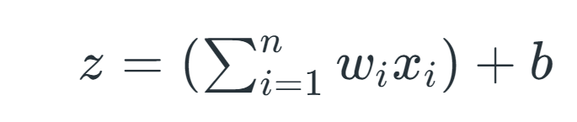
How Logistic regression works?
Logistic regression works by creating a linear combination of input features, which involves multiplying each feature by a coefficient and summing the results.
Applies the multi-linear function to the input variables
xi​ is the ith observation of X
wi=[w1,w2,w3,⋯,wm] is the weights or Coefficient
b is the bias term also known as intercept.
This value is then passed through the logistic (sigmoid) function, which transforms it into a probability value between 0 and 1.

Slide 49
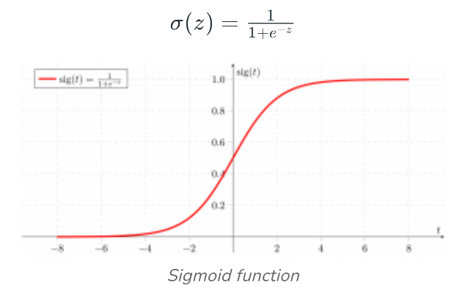
Z will be input to the sigmoid function and find the probability between 0 and 1.
Sigmoid function converts the continuous variable data into the probability
i.e. between 0 and 1.
For binary classification, this probability is compared to a threshold (usually 0.5) to decide the class label.

Slide 50
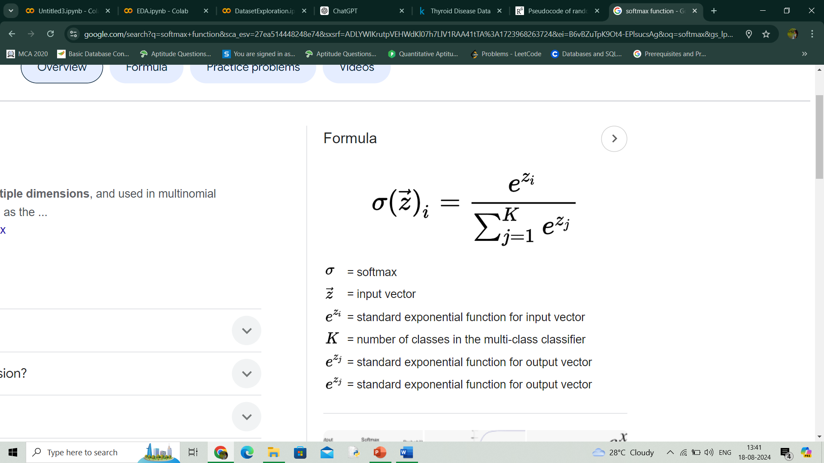
Multinomial logistic regression, also known as softmax regression, is used for multi-class classification tasks, where there are more than two possible outcomes for the output variable.
Target variable can have 3 or more possible types which are not ordered.
In this case, the softmax function is used in place of the sigmoid function.
Softmax function for K classes will be:
The calculated probabilities will be in the range of 0 to 1.
The sum of all the probabilities is equals to 1.
The class with highest probability will be the final output.

Slide 51
Pseudocode
1. Input:
- Training data with N samples and M features.
- Learning rate (how big of a step to take when updating weights).
- Number of iterations (how many times to update weights).
2. Set weights and bias to 0 (or small random numbers).
3. For a set number of iterations:
a. For each sample in the training data:
i. Calculate the weighted sum (z):
z=(weight_1*feature_1)+(weight_2*feature_2)+...+(weight_M*feature_M) + bias

Slide 52
ii. Apply the sigmoid function to get a probability, probability = 1 / (1 + exp(-z))
iii. Calculate the error : error = probability - actual_label
iv. Update each weight:
weight_j = weight_j - (learning rate * error * feature_j)
v. Update the bias:
bias = bias - (learning rate * error)
4. After finishing all iterations, use the weights and bias to make predictions:
a. For a new sample:
i. Calculate the weighted sum (z) using the final weights and bias.
ii. Apply the sigmoid function to get a probability.
iii. If the probability is 0.5 or higher, output class 1. Otherwise, output class 0.

Slide 53
SUPPORT VECTOR MACHINE
Supervised learning technique.
SVM finds a hyperplane that best separates the two classes.
There can be infinite number of hyperplanes passing through a point and classifiying the classes perfectly.
The best hyperplane is the one with maximum marginal distance.
The main objective of the SVM algorithm is to find the optimal hyperplane in an N-dimensional space that can separate the data points in different classes.
The dimension of the hyperplane depends upon the number of features.

Slide 54
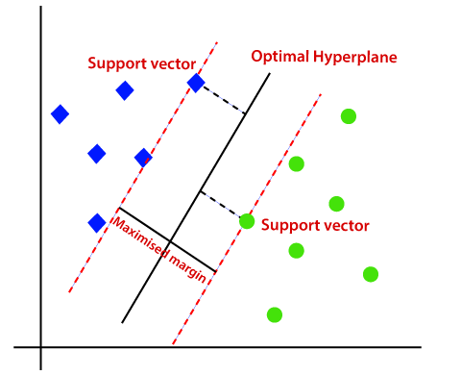
There can be multiple lines/decision boundaries to segregate the classes in n-dimensional space, but we need to find out the best decision boundary that helps to classify the data points.

Slide 55
SVM chooses the extreme points/vectors that help in creating the hyperplane. These extreme cases are called as support vectors, and hence algorithm is termed as Support Vector Machine.
The SVM algorithm has the characteristics to ignore the outlier and finds the best hyperplane that maximizes the margin. SVM is robust to outliers. So the margins in these types of cases are called soft margins.
Non-Linear SVM : Non-Linear SVM can be used to classify data when it cannot be separated into two classes by a straight line (in the case of 2D). By using kernel functions, nonlinear SVMs can handle nonlinearly separable data. The original input data is transformed by these kernel functions into a higher-dimensional feature space, where the data points can be linearly separated. A linear SVM is used to locate a nonlinear decision boundary in this modified space.

Slide 56

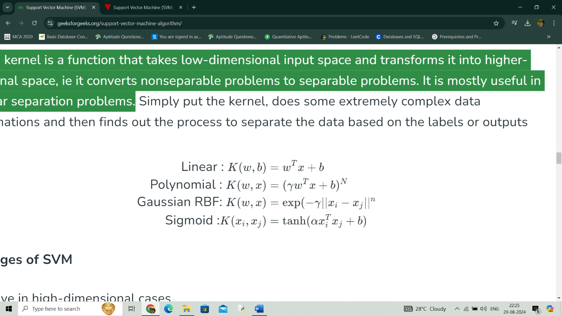
The SVM kernel is a function that takes low-dimensional input space and transforms it into higher-dimensional space, i.e. it converts nonseparable problems to separable problems.
Some commonly used kernel functions are,

Slide 57
How Support Vector Machine works?
Gather dataset which consists of feature inputs and corresponding outputs.
Represent each data point as a vector in a multi-dimensional space, where each dimension corresponds to a feature of the data.
Find the hyperplane that maximizes this margin, ensuring the best possible separation between the two classes.
If the data is not linearly separable, the original feature space is mapped into a higher-dimensional space by using kernel trick where a linear hyperplane can separate the classes.
Find the weights and bias that define the hyperplane by maximizing the margin and minimizing the classification errors.
Once trained, the SVM model can classify new data points. For each new point, the model checks on which side of the hyperplane the point falls.

Slide 58
Pseudocode
1. Initialize Parameters:
- Set the regularization parameter C.
- Initialize weights w and bias b to 0 or small random values.
2. Repeat for a fixed number of iterations:
a. For each data point (xi, yi) in the training set:
i. Calculate the decision function: f(xi) = w * xi + b
ii. If the data point is misclassified (i.e., yi * f(xi) < 1):
- Update weights: w = w + C * yi * xi
- Update bias: b = b + C * yi

Slide 59
3. Prediction:
- For a new data point x_new, compute:
f(x_new) = w * x_new + b
- Return the predicted class:
if f(x_new) >= 0, return +1
else return -1

Slide 60
Packages and Built-in Functions Used
Pandas
- read_csv()
- head()
- shape()
- info()
- drop()
- value_counts()
- isnull()
- describe()
- tail()

Slide 61
Matplotlib
- figure()
- title()
- show()
- xlabel()
- ylabel()
Seaborn
- boxplot()
- countplot()
- heatmap()
- scatterplot()
Numpy

Slide 62
PROJECT PIPELINE
Exploratory
Data Analysis
Data
Preprocessing
Splitting
Dataset
Test
Data
Train
Data
Dataset
Build Model
( RF, LR, SVM )
Best
Model
Input
Thyroid Classification

Slide 63
TIMELINE
Sprint release 1
- Model building using Random Forest
Sprint release 2
- Model building using Logistic Regression
- Model building using Support Vector Machine
Sprint Release 3
- Interface design
- deployment

Slide 64
THANK YOU

